Slide 1
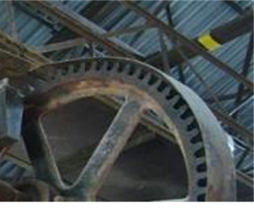
Occupational Hygiene factors that support decision-making in Occupational Safety and Health Management.
Bayo Awosanya CMIOSH, CMFOH.
Project HSSE Advisor/Occupational Hygienist & Trustee World Health Without Border WHWB, UK

Slide 2
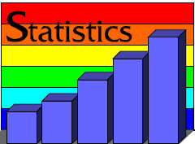
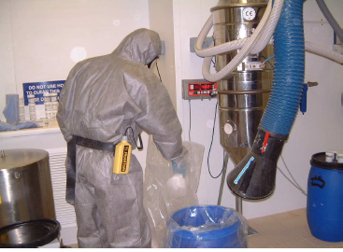
Outline
Overview of Occupational Hygiene Definition
OHS – Conceptual Approach
The Culture Change
Bridging the Gap in Supporting OHS Decision Making
Identifying the OHS Hazards and Risks
Structure the Problem
Looking for Solution
The Act of Making Decision
Implementing, Monitoring and Feedback

Slide 3
Occupational Hygiene
Occupational Hygiene is the science/art associated with
Anticipation
Recognition
Evaluation
Control
Of those risk factors that may affect health and well being of individuals at work or in the community
http://www.ilocis.org/documents/chpt30e.htm

Slide 4
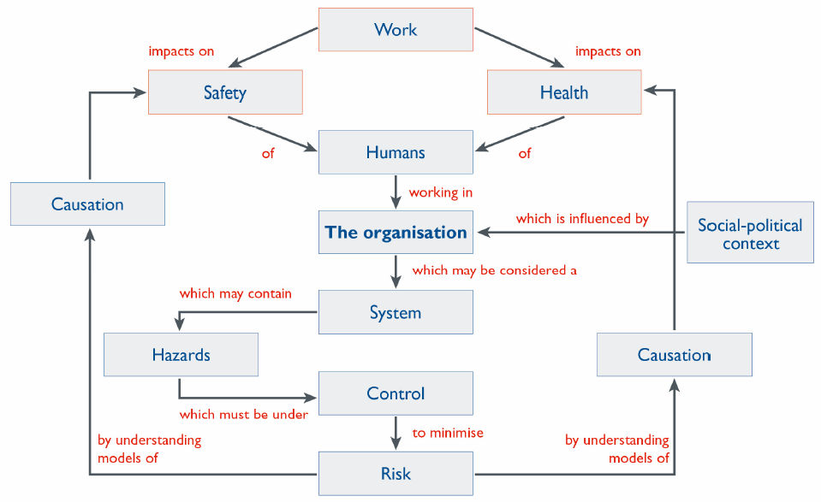
The Conceptual Approach
Reference: ohsbok.org.au/wp

Slide 5
What do you see?

Slide 6
Half Empty
or
Half Full?

Slide 7
…About Culture Change
Half Empty
or
Half Full?

Slide 8
Bridge the Gaps
Identify the OHS Hazards
Structure the problem
Look for possible solution
Making decision
Implement, Monitoring and Feedback

Slide 9
Identify the OHS Hazards
Business objectives and Occupational Hygiene
Gaps in monitoring. Looking at the problem in terms of goals and barriers can offer an effective way of defining many problems.
Besides it helps in splitting bigger problems into smaller ones or manageable sub-problems.
Sometimes it will become apparent that what seems to be a single problem, is more of a series of sub-problems.

Slide 10
Structure an Document it – The role of Risk Assessment
Risk Assessment, documenting risk hazard profile
Relationship between hazards and exposure
Structuring the problem is all about gaining more information about the problem and increasing its understanding.
This means, observe the nature of the problem, collect more details and getting a clear picture of the problem

Slide 11
Creating the solution
Expertise comes into place. If you do not have Occupational Hygiene competence, you can seek support.
Examples
Use of expertise in assessing chair in the purchase of office chairs
Collecting data of crew changes of personnel which informs decision to manage fatigue
Advice on specification for RPE programme
Monitoring of noise levels for Hearing Conservation Programme
Assessment of chemical exposure for PPE Clothing.

Slide 12
Decision Making
Risk-related decisions of interest to the OHS professional
Strategic
Tactical
Operational
Contingency . Example COVID-19
Look at each potential solution and carefully analyse i
Hierarchy of Control
Demonstrate ALARP
Watch for Danger of Decision Making (Delay)
Potential loss of opportunity

Slide 13
Implement, Track, Feedback
Implementation means acting on the chosen solution to the problem.
Remedial Action Plan

Slide 14
About WHWB
Workplace Health Without Borders’ vision is a world where workers, their families and communities do not get ill because of their work. Our mission is to prevent work-related disease around the world through shared expertise, knowledge and skills.
A non-profit international organization
Registered as a charity in Canada
Engages volunteers to address workplace health issues around the world
Join WHWB: www.whwb.org
Volunteer - we need help with projects, communications, fundraising
Participate in our monthly teleconferences
email: info@whwb.org

Slide 15
Thank you

